Slide 1
Object Modeling Technique
Presented by:
Rajesh Gautam(27)
Babin Bista(28)

Slide 2
Contents
Introduction to OMT
Purpose of OMT
Phases of OMT
OMT’s Models

Slide 3
Object Modeling Technique
Object Modeling Technique (OMT) is real world based modeling approach for software modeling and designing.
Object modeling technique is a method for analysis, design and implementation by an object oriented technique.
It was developed basically as a method to develop object-oriented systems and to support object-oriented programming.

Slide 4
Continued…
Diagrammatic approach used for designing in SDLC.
It describes the static structure of the system.
OMT was developed by James Rambaugh.

Slide 5
Purpose of OMT
To test physical entity before construction of them.
To make communication easier with the customers.
To present information in an alternative way i.e. visualization.
To reduce the complexity of software.
To solve the real world problems.

Slide 6
Phases of OMT
Analysis
System Design
Object Design
Implementation

Slide 7
Analysis
This the first phase of the object modeling technique.
This phase involves the preparation of precise and correct modeling of the real world problems.
Analysis phase starts with setting a goal i.e. finding the problem statement.
Problem statement is further divided into above discussed three models i.e. object, dynamic and functional model.

Slide 8
System Design
This is the second phase of the object modeling technique and it comes after the analysis phase.
It determines all system architecture, concurrent tasks and data storage.
High level architecture of the system is designed during this phase.

Slide 9
Object Design
Object design is the third phase of the object modeling technique.
Object design phase is concerned with classification of objects into different classes and about attributes and necessary operations needed.
Different issues related with generalization and aggregation are checked.

Slide 10
Implementation
This is the last phase of the object modeling technique.
It is all about converting prepared design into the software.
Design phase is translated into the Implementation phase.

Slide 11
OMT’s Models:
Object Model
Dynamic Model
Functional Model

Slide 12
Object Model
The object model describes:
- the structure of the object
- the relationship of one object with other objects
- attributes and operations of the objects.
Captures the concepts from the real world that are useful for the application.
Represented by class diagram and object diagram.

Slide 13
Object Diagram
Models the instances of classes that are present in class diagram.
Used to model the static design view of the system.
Defines the attributes and operations of each object.
Object diagram contains:
• Objects
• Links

Slide 14
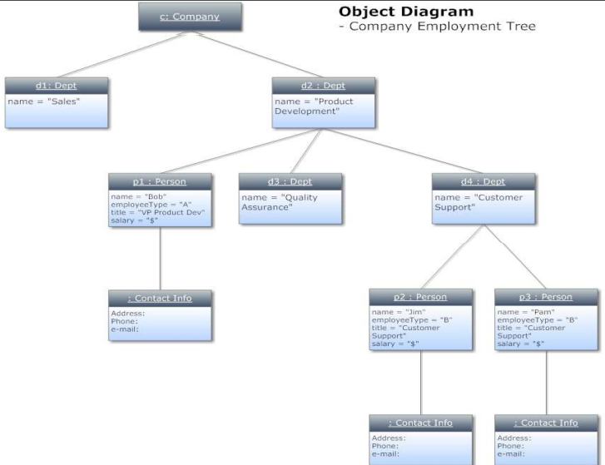

Slide 15
Class Diagram
A graphical representation used for modeling classes and their relationships.
Describes all possible objects belonging to the classes.
Used for abstract modeling and for implementing actual program.
The class diagram is concise and can be understood easily.

Slide 16
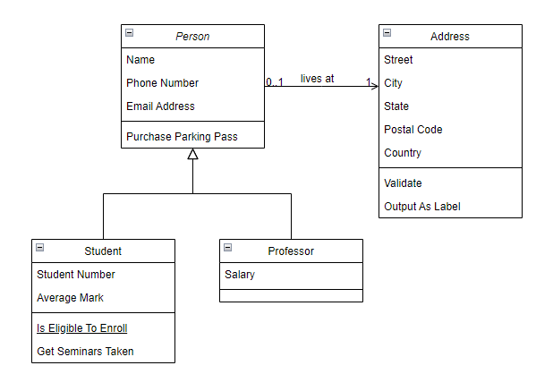

Slide 17
Dynamic Model
Dynamic Model involves states, events and state diagram (transition diagram) on the model.
Main concepts related are states, transition between states and events to trigger the transitions.

Slide 18
Continued…
A state is when a system is doing something or waiting for something to happen .
Transition refers to instantaneous change in state.
A condition is typically some kind of event.
An action is the appropriate output or response to the event.

Slide 19
Functional Model
It describes how one object collaborates with other in order to achieve behavior of the system.
Overall behavior of system represented with the help of dynamic and functional model.
Includes use case diagram, sequence diagram and activity diagram.
Represented by data flow diagram.

Slide 20
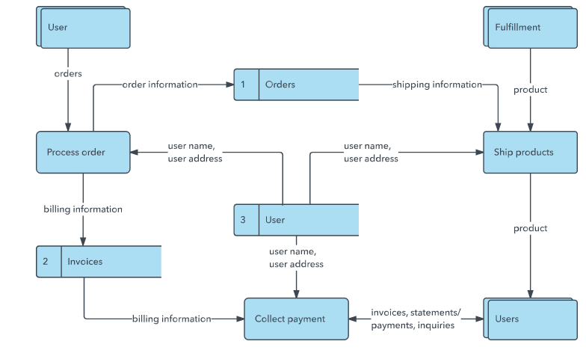

Slide 21
THANK YOU

